Slide 1
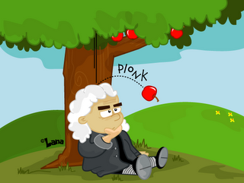
Isaac Newton (1670’s)
Realized that objects move due to forces (e.g. Gravity)
Improved on Galileo’s ideas
Developed 3 Laws of Motion
Inertia (When a = 0)
F = ma (When a <> 0)
Action / Reaction
Proved that the forces that govern the motion of objects on Earth are the same as the forces that govern objects in the Heavens

